Slide 1

Data Structures and Algorithms
(ES221)
Expression Trees
Dr. Zubair Ahmad

Slide 2
Expression Trees
An expression tree is a binary tree used to represent arithmetic expressions.
In this tree:
Leaves (terminal nodes) represent operands (e.g., constants or variables).
Internal nodes represent operators (e.g., +, -, *, /).
Each subtree represents a subexpression.

Slide 3
Why Use Expression Trees?
To evaluate expressions
To convert between infix, postfix, and prefix notations
For compiler design (e.g., code generation and optimization)

Slide 4
Expression Trees
The leaves of an expression tree are operands
such as constants or variable names
Non-leave nodes contain operators
This particular tree (next slide) happens to be binary
because all of the operations are binary
However, more than two children per node is also possible in an expression tree
It is also possible for a node to have only one child, as is the case with the unary minus operator.
We can evaluate an expression tree, T, by applying the operator at the root to the values obtained by recursively evaluating the left and right subtrees.

Slide 5
Traversal Type | Output | Form
Inorder | 3 + 5 * 2 | Infix
Preorder | + 3 * 5 2 | Prefix
Postorder | 3 5 2 * + | Postfix
Traversal | Order | Output for Expression (3 + (5 * 2))
Inorder | Left, Node, Right | 3 + 5 * 2
Preorder | Node, Left, Right | + 3 * 5 2
Postorder | Left, Right, Node | 3 5 2 * +

Slide 6
Expression Tree – Inorder Traversal
We can produce an (overly parenthesized) infix expression
This general strategy ( left, node, right ) is known as an inorder traversal
it is easy to remember because of the type of expression it produces.
+
+
*
a
*
+
g
b
c
*
f
d
e

Slide 7
Expression Tree – Inorder Traversal
Print a left parenthesis
Traverse the left subtree
Print the root
Traverse the right subtree
Print a right parenthesis
+
+
*
a
*
+
g
b
c
*
f
d
e

Slide 8
Expression Tree - Example
The left subtree evaluates to a + (b * c) ,and
The right subtree evaluates to ((d *e) + f )*g
The entire tree therefore represents (a + (b * c)) + (((d * e) + f)* g)
+
+
*
a
*
+
g
b
c
*
f
d
e

Slide 9
Expression Tree - Inorder Traversal Example
Left + Right
Left → (Left + Right)
→ (Left + (Left * Right))
→ (a + ( b * c ))
Right → ( Left * Right)
→ ((Left + Right) * Right)
→(((Left * Right) + Right) * Right)
→((( d * e ) + f ) * g )
Left + Right →
(a + ( b * c )) + ((( d * e ) + f ) * g )
+
Left
Right
+
*
Left
Left
Right
a
Right
*
+
g
Left
Right
Right
b
c
Left
f
*
Left
Right
d
e

Slide 10
Expression Tree – Preorder Traversal Example
Left + Right → + Left Right
Left → + Left Right
→ + Left * Left Right
→ + a * b c
Right → * Left Right
→ * + Left Right Right
→ * + * Left Right Right Right
→ * + * d e f g
Left + Right → + Left Right
+ + a * b c * + * d e f g
`
`
+
Left
Right
+
*
Left
Left
Right
a
Right
*
+
g
Left
Right
Right
b
c
Left
f
*
Left
Right
d
e

Slide 11
Expression Tree – Postorder Traversal Example
Left + Right → Left Right +
Left →
→ a b c * +
Right →
→ d e * f + g *
Left + Right → Left Right +
a b c * + d e * f + g * +
+
+
*
a
*
+
g
Left
Right
b
c
*
f
Left
Right
d
e

Slide 12
Expression Tree – Preorder Traversal Recursive Implementation
preorder(node)
if node = NULL then return
print node.value // Print the root preorder(node.left) // Traverse the left subtree
preorder(node.right) //Traverse the right subtree
+
+
*
a
*
+
g
b
c
*
f
d
e

Slide 13
Expression Tree – Inorder Traversal Recursive Implementation
inorder(node)
if node = then return
inorder(node.left) // Traverse the left subtree
print node.value // Print the root
inorder(node.right) //Traverse the right subtree
+
+
*
a
*
+
g
b
c
*
f
d
e

Slide 14
Expression Tree – Postorder Traversal Recursive Implementation
postorder(node)
if node = NULL then return
postorder(node.left) // Traverse the left subtree
postorder(node.right) //Traverse the right subtree
print node.value // Print the root
+
+
*
a
*
+
g
b
c
*
f
d
e

Slide 15
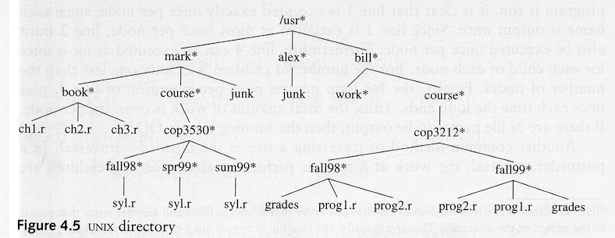
UNIX Directory An example of non-binary tree

Slide 16
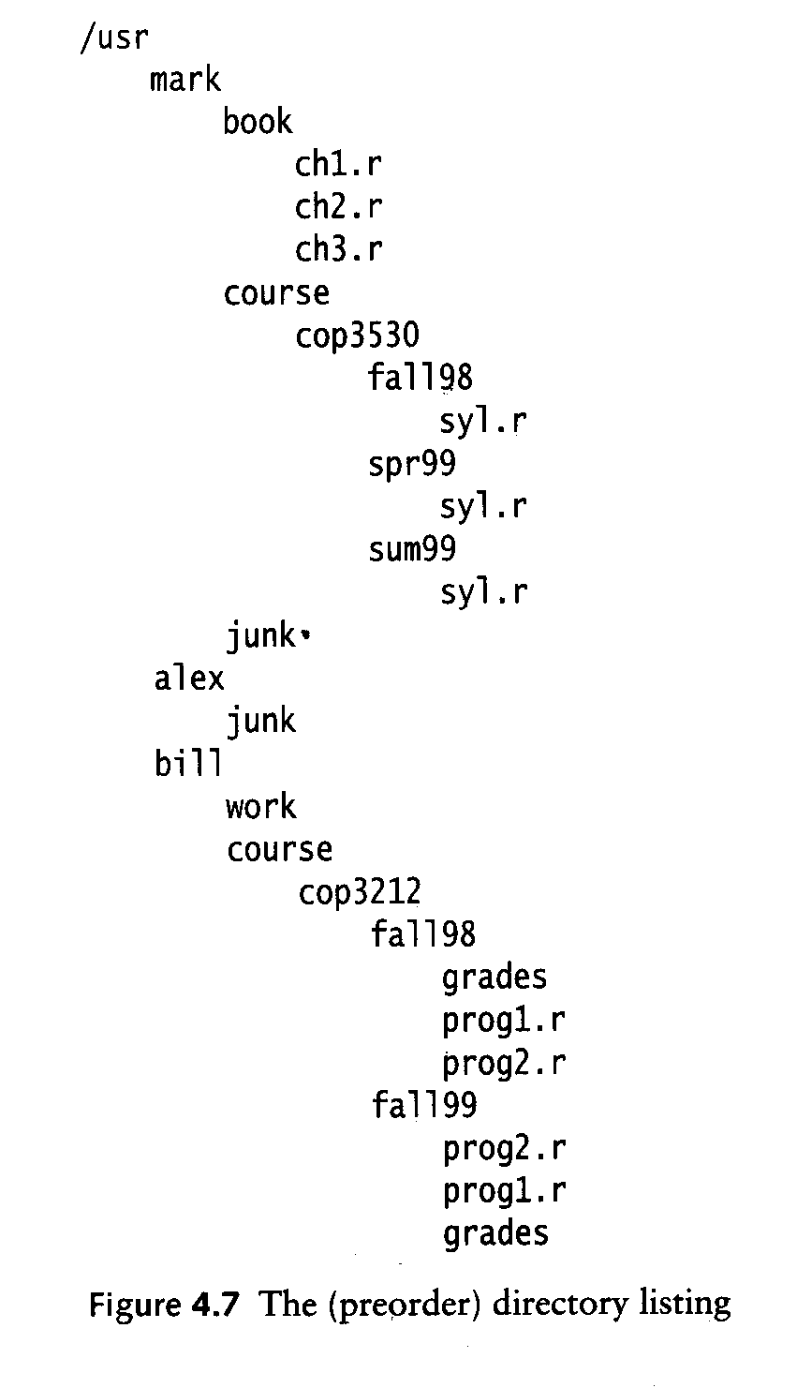
Preorder Traversal
of UNIX directory
Asterisks (*) denote directories.
Entries without asterisks (e.g., ch1.r, syl.r, prog1.r) are files.
The structure mimics a tree where:
Branches are directories (folders).
Leaves are files.

Slide 17
Expression Tree Traversal Non Recursive Implementaion
The recursive implementations will require to call and maintain stack space proportional to the height of the tree.
In a poorly balanced tree, this can be quite considerable.
We can remove the stack requirement by maintaining parent pointers in each node, or by threading the tree

Slide 18
In a Threaded Binary Tree, we use the otherwise NULL pointers to make traversal faster without recursion or a stack:
Left thread: Points to the inorder predecessor if left child is NULL.
Right thread: Points to the inorder successor if right child is NULL.

Slide 19
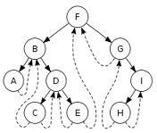
Expression Tree Traversal Non Recursive Implementaion
A binary tree is threaded by
making all right child pointers (that would normally be null) point to the inorder successor of the node, and
all left child pointers (that would normally be null) point to the inorder predecessor of the node.

Slide 20
Expression Tree Traversal Non Recursive Implementaion
A threaded binary tree makes it possible to traverse the values in the binary tree via a linear traversal that is more rapid than a recursive in-order traversal.
It is also possible to discover the parent of a node from a threaded binary tree, without explicit use of parent pointers or a stack, although slowly.
This can be useful where stack space is limited, or where a stack of parent pointers is unavailable

Slide 21
(3 + (5 * 2))
Node | Left Child | Right Child | Left Thread (inorder predecessor) | Right Thread (inorder successor)
3 | NULL | NULL | NULL | +
+ | 3 | * | 3 | 5
5 | NULL | NULL | + | *
* | 5 | 2 | 5 | 2
2 | NULL | NULL | * | NULL

Slide 22
Expression Tree – Inorder Traversal
inorder(node)
while hasleftchild(node) do
node = node.left
do
visit(node)
if (hasrightchild(node)) then
node = node.right
while hasleftchild(node) do
node = node.left
else
while node.parent ≠ NULL && node == node.parent.right do node = node.parent
node = node.parent
while node ≠ NULL

Slide 23
Expression Tree – Inorder Traversal
inorder(node)
while hasleftchild(node) do
node = node.left
do
visit(node)
if (hasrightchild(node)) then
node = node.right
while hasleftchild(node) do
node = node.left
else
while node.parent ≠ NULL && node == node.parent.right do
node = node.parent
node = node.parent
while node ≠ NULL
+
+
*
a
*
+
g
b
c
*
f
d
e
a
+
b
*
c
+

Slide 24
Questions?
zahmaad.github.io

